Slide 1

Sentiment Analysis in Twitter
By:
Nishad Abdul Latheef
Tojo James

Slide 2

Introduction
Twitter is one of the most popular social networking site used for microblogging.
Each tweets are restricted to 280 characters.
All over the world, twitter is used as a platform to convey one’s emotions.
Some companies even target on analysing these emotions on a particular topic for various purposes.
The aim of the assignment is to build a model to detect and summarise the sentiments using the tweets on random topics.

Slide 3

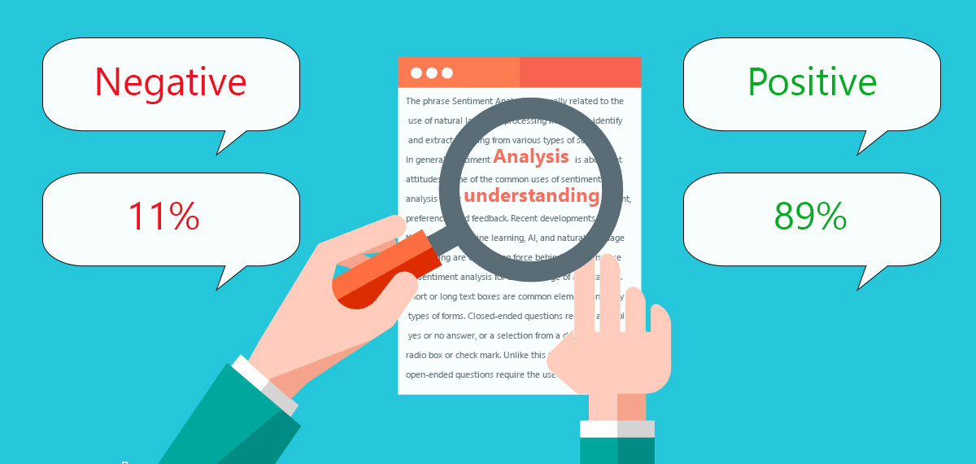
What is Sentiment Analysis?
It is a text mining technique to extract, identify and study the polarity of a given text or document.
The results show whether the emotion conveyed in the document is positive, or negative
In principle, the accuracy of a sentiment analysis system is determined by how well it finds similarity with human judgments.
This is usually calculated by different measures based on precision and recall over the two target variables of negative and positive texts.

Slide 4

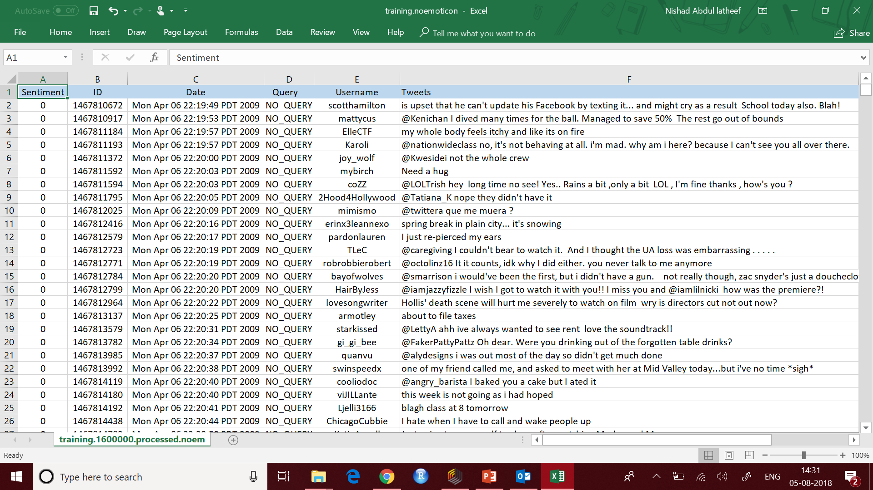
Data Set
The training set is an excel file that contains 200,000 rows and 6 columns.
The six fields of the training set are:
the polarity of the tweet (0 = negative and 4 = positive).
the id of the tweet.
the date of the tweet.
the query. If there is no query, then this value is NO_QUERY.
the user that tweeted.
the text of the tweet.
A test set with 50,000 rows of tweets and emotions are used for predicting the sentiments.

Slide 5
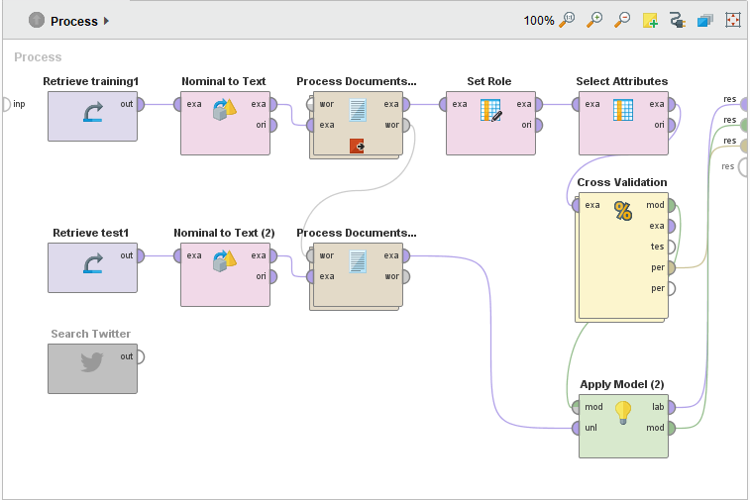
Process in Rapidminer
Rapidminer is used for carrying out the analysis.

Slide 6
Methodology
The main steps that are carried out in Rapidminer are:
The training set is loaded into the process using Read excel operator.
The type of selected nominal attributes is changed to text before it is processed in process document operator.
The roles are set along with attribute selection in order to selected the required attribute.
This is fed to the validation operator where different algorithms are used to predict and test the accuracy of the predictions on the cross validation set.
The validated model is then used on the test set in order to predict the sentiments and find the accuracy of the model.

Slide 7
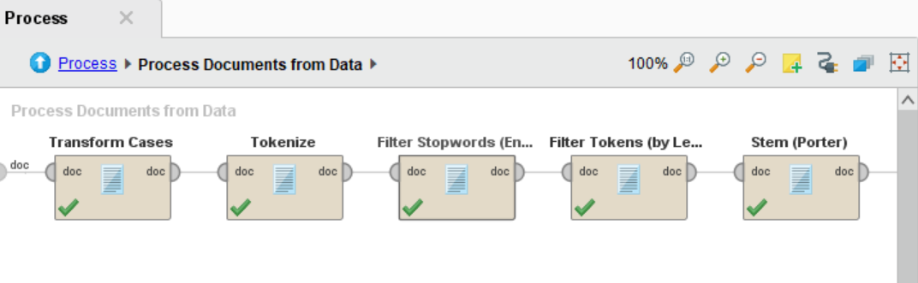
Process Document
The process document operator consists of the following steps:
Transform Cases - Transforms cases of characters in a document
Tokenize - splits the text of a document into a sequence of tokens
Filter Stopwords - filters English stopwords from a document by removing every token matching built-in stop-word list.
Filter Tokens - Filters tokens based on their length
Stem (Porter) - stems English words using the Porter stemming algorithm that reduce the length of the words until a minimum length is reached

Slide 8
Algorithm
The algorithms we chose for this sentiment analysis are
Decision tree
Naive Bayes
SVM
Out of these, Support Vector Machine showed the maximum accuracy for the given dataset.
support vector machines are supervised learning models with associated learning algorithms that analyze data used for classification and regression analysis.

Slide 9

Applying the CRISP-DM model
Every step of this analysis was carried out with the CRISP-DM data modelling steps in mind.
Business Understanding
Data Understanding
Data Preparation
Modelling
Evaluation
Deployment

Slide 10
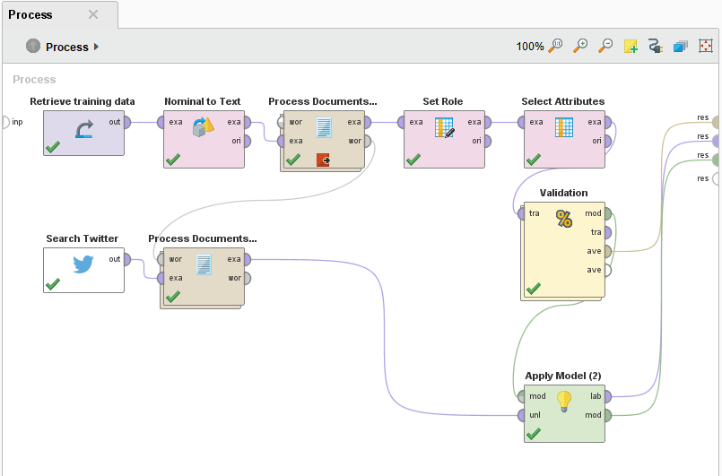
1.Business Understanding 2. Data Understanding
3.Data Preparation
4.Modelling
5. Evaluation
6. Deployment

Slide 11
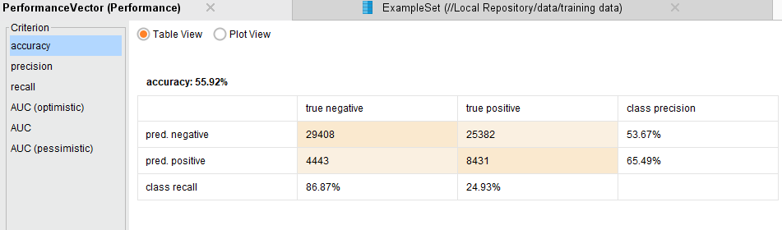
Performance
Decision Tree

Slide 12
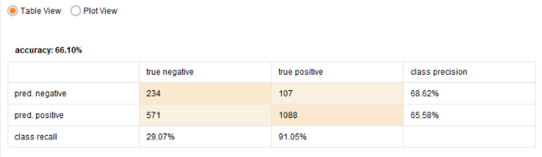
Performance
SVM
The SVM algorithm shows the highest rate of accuracy on predicting the sentiment of a tweet in the validation model.
Applying this model on the test dataset.

Slide 13
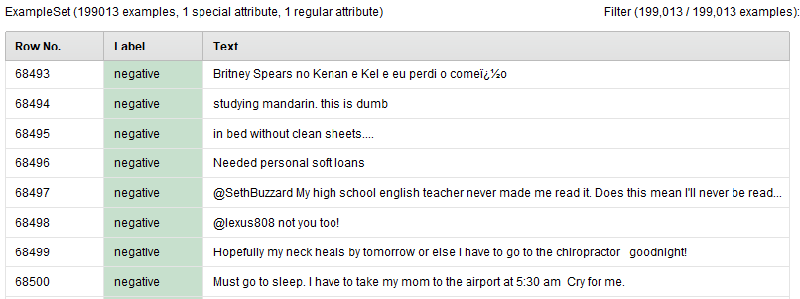
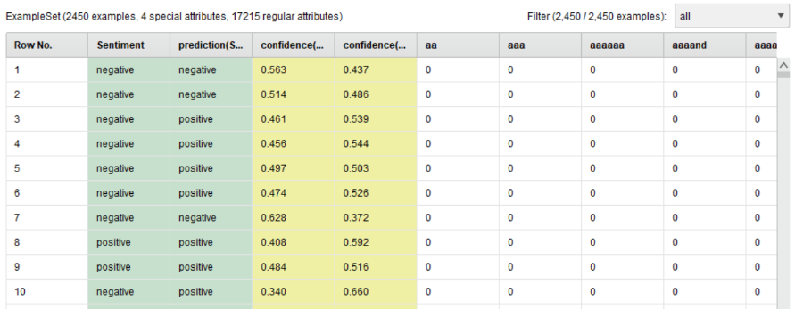
Result
Validation:
On the test data:

Slide 14
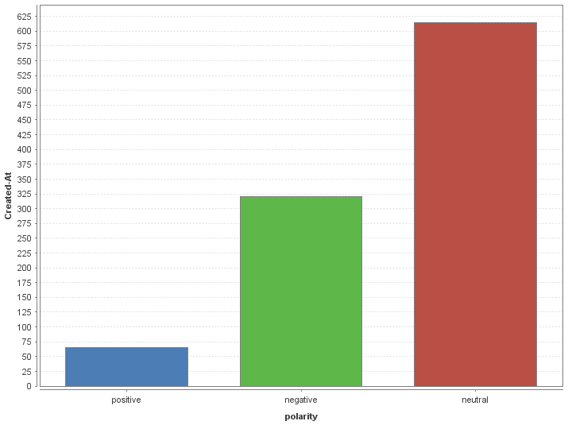

Results on different datasets
Donald Trump tweets:

Slide 15
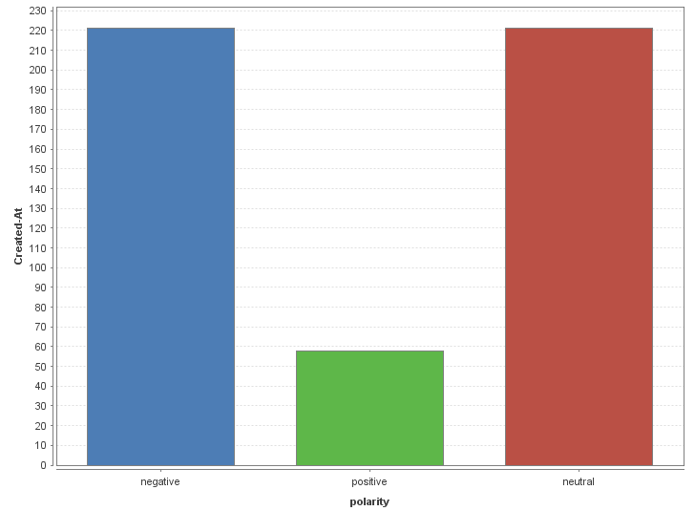

Barack Obama tweets:

Slide 16
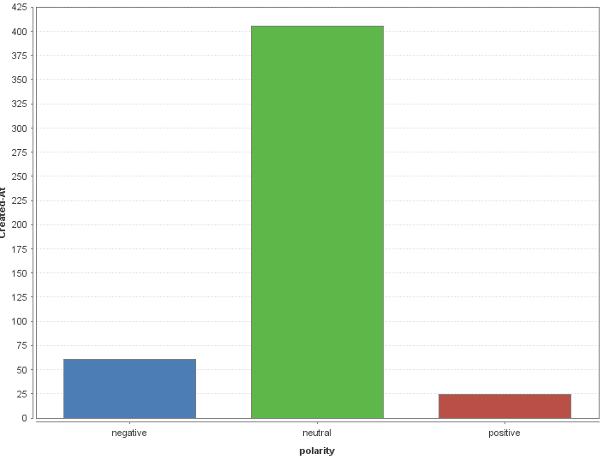

Narendra Modi tweets:

Slide 17


